Slide 1
DataQuest ’24: Using AI To Detect Credit Card Fraud
Christopher Tela, Jisa Pius, Kalan Roye

Slide 2





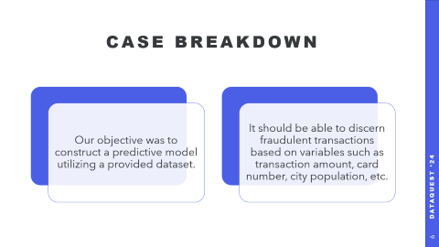
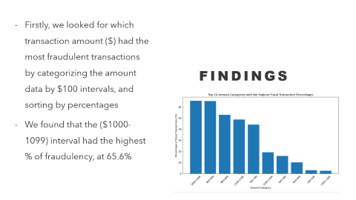
Table of Contents
Problem Understanding & Research
DataQuest AI Competition 2024
Dataset Analysis & Findings
Model Creation, Outputs, & Accuracy
In this section we will discuss the problem we are faced with and the plan we developed to solve it.
Duration – 01:30
Conclusions

Slide 3



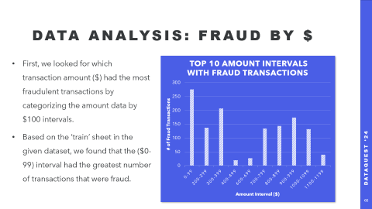

Table of Contents
Problem Understanding & Research
DataQuest AI Competition 2024
Dataset Analysis & Findings
Model Creation, Outputs, & Accuracy
In this section we will discuss the dataset we were given and some patterns we noticed within it.
Duration – 03:45
Conclusions

Slide 4

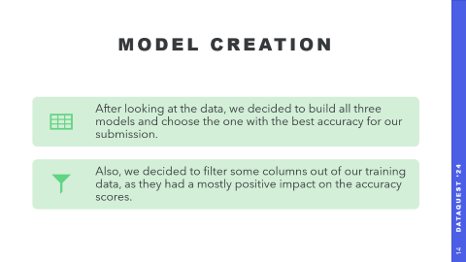

Table of Contents
Problem Understanding & Research
DataQuest AI Competition 2024
Dataset Analysis & Findings
Model Creation, Outputs, & Accuracy
In this section we will discuss which method we used to build our model and how it performed in testing.
Duration – 03:30
Conclusions

Slide 5

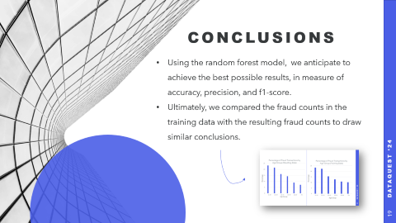

Table of Contents
Problem Understanding & Research
DataQuest AI Competition 2024
Dataset Analysis & Findings
Model Creation, Outputs, & Accuracy
In this section we wrap up the presentation with any final notes.
Duration – 00:30
Conclusions

Slide 6
Case Breakdown
Our objective was to construct a predictive model utilizing a provided dataset.
It should be able to discern fraudulent transactions based on variables such as transaction amount, card number, city population, etc.

Slide 7
Machine Learning Models
We had to choose a model that would suit our needs and dataset and provide the most accuracy. Our choices were:
Logistic Regression: A statistical method that tries to model the relationship between a dependent variable and one or more independent variables using a straight line
Decision Tree Regression: Uses a tree-like model of decisions. It splits the data into different partitions based on certain conditions and makes a prediction for each partition.
Random Forest: Uses a collection of decision trees. It creates multiple decision trees on subsets of the data and averages their predictions.

Slide 8
Data Analysis: Fraud by $
First, we looked for which transaction amount ($) had the most fraudulent transactions by categorizing the amount data by $100 intervals.
Based on the ‘train’ sheet in the given dataset, we found that the ($0-99) interval had the greatest number of transactions that were fraud.

Slide 9
Data Analysis: Fraud By $
Additionally, we found that transactions over $1000 have much higher rate of fraudulency compared to those under $1000.
We can assume that transactions that are abnormally high have a higher chance of fraudulency.

Slide 10
Data Analysis: Fraud by State

Slide 11
Data Analysis: Fraud by State
Next, we analyzed the fraudulent transactions by state and identified Rhode Island as a significant outlier, exhibiting a fraud rate approximately 16 times higher than the next highest state.
This anomaly can be attributed to Rhode Island’s relatively small population (ranked 7th smallest in the U.S. at 1.04 million), suggesting the likelihood of a single individual perpetrating repeated fraudulent activities.

Slide 12
Data Analysis: Fraud by Card Company
Then, we devised a way to determine the amount of fraudulent transactions were committed under a specific credit card company based on the card’s first few digits.
We found lesser-known companies are used more in fraudulency. (Only 8% of Americans use Discover, compared to Visa (48%) & Mastercard (36%))
(https://www.bankrate.com/finance/credit-cards/credit-card-market-share-statistics/)

Slide 13
Data Analysis: Fraud by Transaction Type
One of our final findings was that the type of transaction plays a crucial role in determining fraudulency.
Shopping online has an 18.6x chance of fraudulency in comparison to travel.

Slide 14
Model Creation
After looking at the data, we decided to build all three models and choose the one with the best accuracy for our submission.
Also, we decided to filter some columns out of our training data, as they had a mostly positive impact on the accuracy scores.

Slide 15



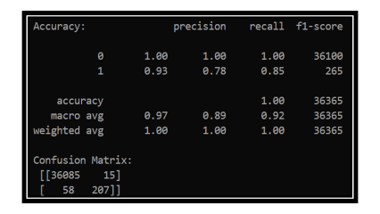
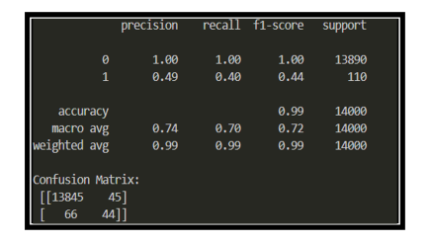
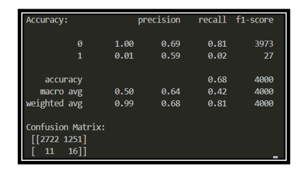
Model Accuracy Comparisons
When comparing the outputs of the three machine learning models, noticeable differences were observed.
Logistic Regression
Decision Tree Regression
Random Forest Model

Slide 16
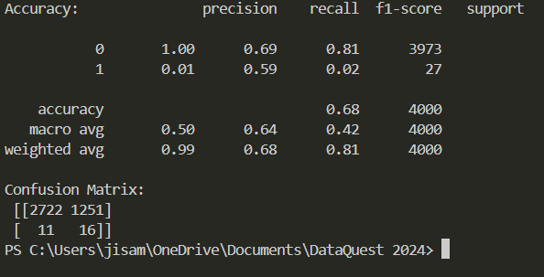




Slide 17
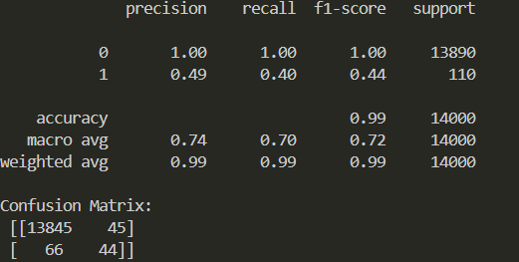
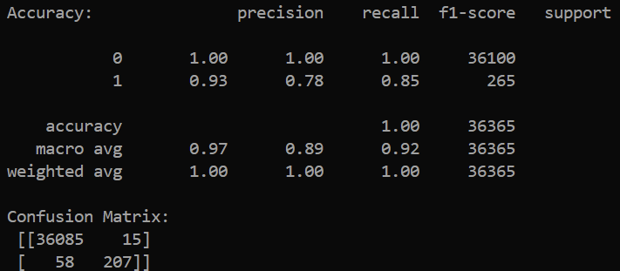







Slide 18





Slide 19
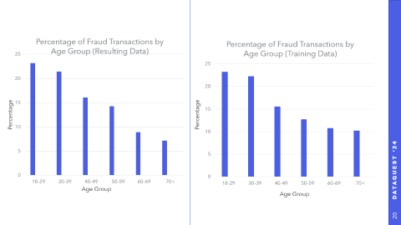
Conclusions
Using the random forest model, we anticipate to achieve the best possible results, in measure of accuracy, precision, and f1-score.
Ultimately, we compared the fraud counts in the training data with the resulting fraud counts to draw similar conclusions.

Slide 20
Percentage
Percentage
Age Group
Age Group

Slide 21
THANK YOU!
We appreciate your time. Any questions?

